Slide 1
MeetCute;)
Final Presentation!
Notes:
Hi everyone this is team-2, <intro teammates>

Slide 2
Road Map
20%
90%
View ^LandingPage ^Message
^Profile
^Discover
Control ^Log in/out ^send Message
^editing profile
Model ^Initialized all tables
Milestone Profile+Discover system done.^ Pass Acceptance^
Message System Done^
Notes:
After assiduous hard-working, We finally achieved almost 50% percent of our work. Gautam: bs

Slide 3
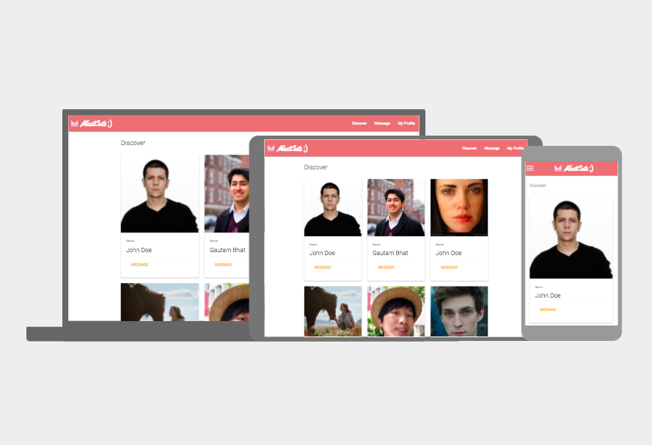
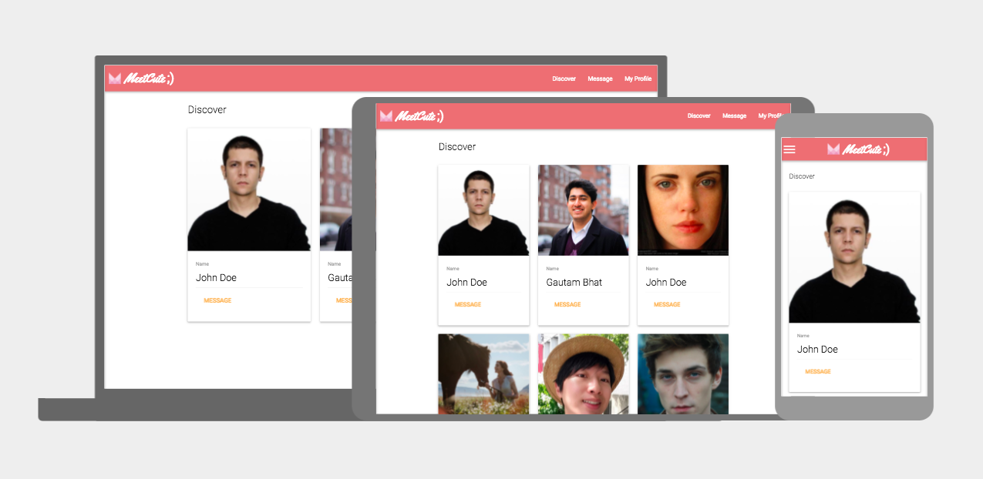
MeetCute
Notes:
After assiduous hard-working, We finally achieved almost 50% percent of our work. Gautam: bs

Slide 4
Agenda
User story Implementation
Design Testing Refactoring
Metrics Project Management/Process
Security Lessons learned Future work
Notes:
http://meet-cute.me:3000/

Slide 5
MeetCute;)
Requirement Analysis and User stories
Gautam
Notes:
Demo Profile Page editing, and Message Page Sending msg

Slide 6
Requirement Analysis
Basic Features:
Facebook Registration
Facebook login and logout
Discover users
View Profiles
Edit Your Own Profile Introduction
Messaging
Nice-to-haves
Emojis
Attachments
Add more pictures
Favorite/star a user

Slide 7
User Stories
Support for emojis
“As a logged-in user, I want to be able to send emoji in my messages.”
“Given a logged-in user, when emoji shortnames are typed in messages, they should be displayed as emoji icons.”
Real-time chat
“As a logged-in user, I want to be able to chat in real-time with other users.”
“Given a logged-in user, when someone sends a message, it should be displayed without reloading the page.”

Slide 8
User Stories
Profile editing
“As a logged-in user, I want to be able to edit my self-introduction”
“Given a logged-in user, when I type in text in my edit profile tab and press enter, Then it should save the self intro.
Discover page links
“As a logged-in user, I want to be able to visit other people’s profiles”
“Given a logged-in user, when I click a user in discover page, then the user should be redirected to corresponding profile page.”

Slide 9
User Stories
Hiding data from logged-out users
“As a user who is not logged in, I want other users’ data hidden from me”
“Given a logged out user, when click on Messaging or Discover tab, profiles and messages should not be displayed.”
Appropriate “Logout” button display
“As a user, I want to see the LOGOUT button only when I am logged into the app”
“Given a logged-in user, when on landing page, LOGOUT button should be visible.”
“Given a logged-out user, when on landing page, LOGOUT button should not display.”

Slide 10
MeetCute;)
Implementation Details
Gautam
Notes:
Demo Profile Page editing, and Message Page Sending msg

Slide 11



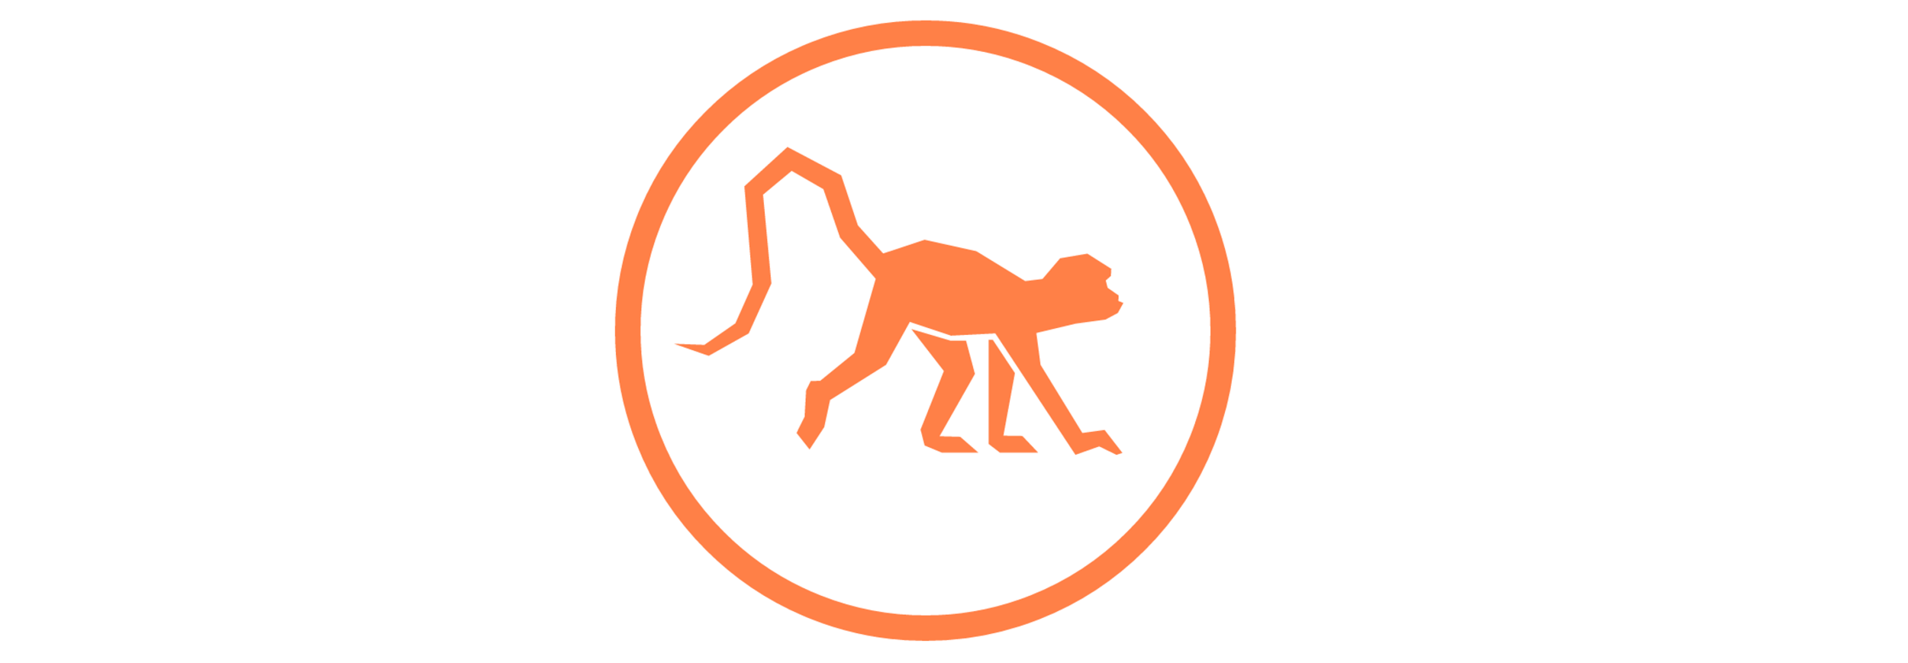






All the Tech!
Framework - Meteor
ReactJS, Node.JS, MongoDB, Blaze and Ember templates
Version Control - Git, Github
Documentation - JSDocs
Deployment - DigitalOcean, MeteorUp, nginx
Testing - Chimp (Selenium + WebdriverIO)
Communication - Slack
Progress Management - PivotalTracker

Slide 12
Meteor
Full-Stack Javascript
Application Server : Node.JS, MongoDB
Web browser : ReactJS, MiniMongo
Real-time collaboration
Data on the wire
Browser and server exchanging JSON data, not HTML
Reduces development time
Great for agile, start-up environment!

Slide 13
Database Design
message collection
profile collection
{
_id : BSON Object
text : String
fromId : String
toId : String
ImgId : BSON Object
createdAt : Date
}
{
_id : BSON Object
name : String
dob : Date
Intro : String
}
messageRoom collection
Image collection
{
_id : BSON Object
newMId : BSON Object
numMsg : Integer
UId1 : BSON Object
UId2 : BSON Object
createdAt : Date
updatedAt : Date
}
{
_id : BSON Object
userId : String
serviceId : String
service : String
type : String
createdAt : Date
}

Slide 14
Facebook login
Facebook login uses OAuth 2.0
MeetCute registers with Facebook, and obtains a Secret and an ID.
When User tells MeetCute to access Facebook, User is sent to Facebook where she tells Facebook that she would indeed like to give MeetCute permissions to specific information.
Facebook redirects User back to MeetCute, along with an Authorization Code.
MeetCute then passes that Authorization Code along with its Secret back to Facebook in return for a Security Token.
MeetCute then makes requests to Facebook on behalf of User by bundling the Security Token along with requests.
Notes:
OAuth is an authorization protocol,this is the standard for third party authentication

Slide 15
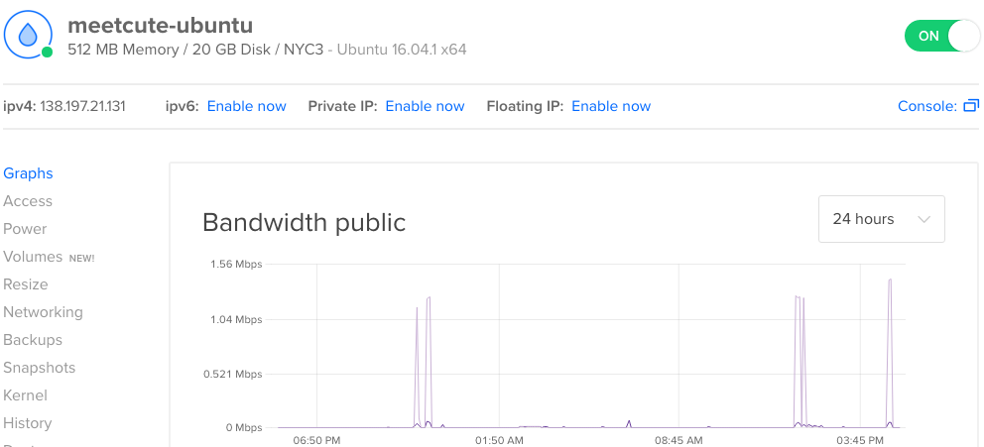
Deploying on DigitalOcean

Slide 16
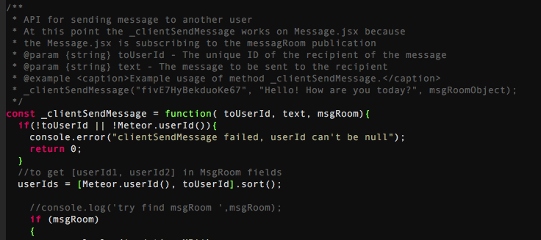
Documentation Generation

Slide 17
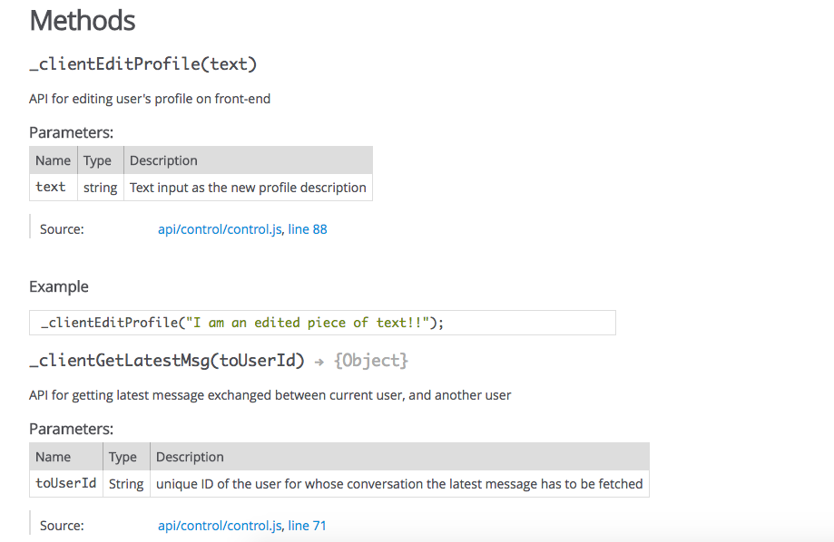
Documentation Generation

Slide 18
Demo
http://meet-cute.me:3000/ Documentation for classes and methods:
http://gautambhat.github.io/meetcute-docs
Notes:
http://meet-cute.me:3000/

Slide 19
MeetCute;)
Design
Adiba

Slide 20
MVC / MVVM
Meteor.js framework is flexible enough to allow the software architecture to implement the patterns they choose.
Our implementation uses hybrid of the Model - View - Controller and Model-View-ViewModel patterns.
Views are comprised of nested Components that define the content of the pages
Views can retrieve models directly from the database.
Most events are handled in the View
however any Events resulting in a model update are handled by the Controller.

Slide 21
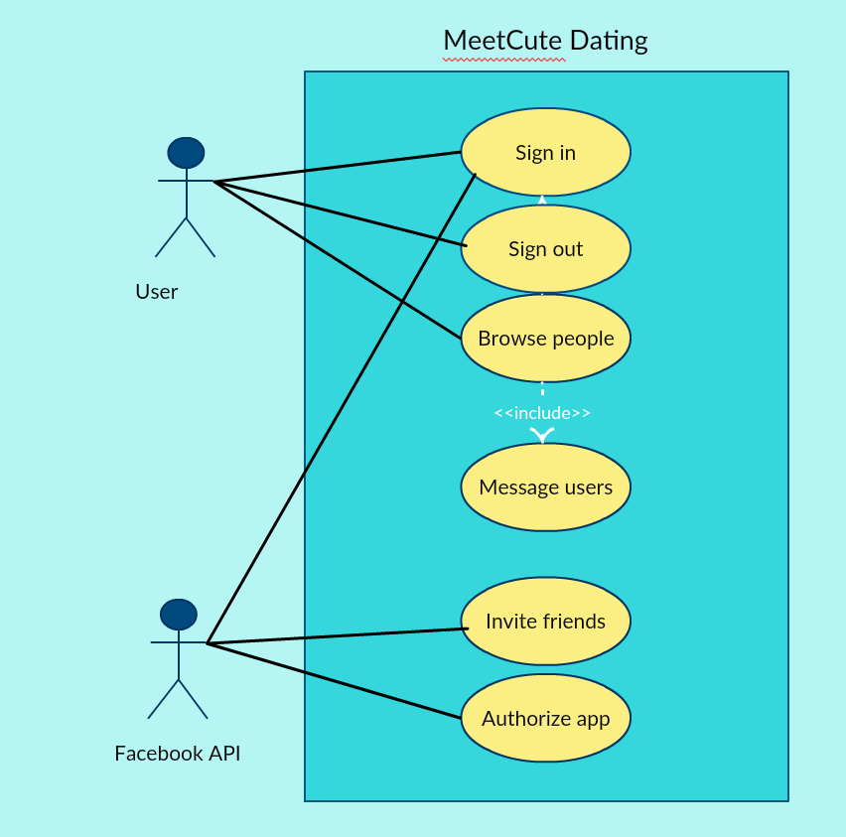
Use case diagram for Meetcute;)

Slide 22
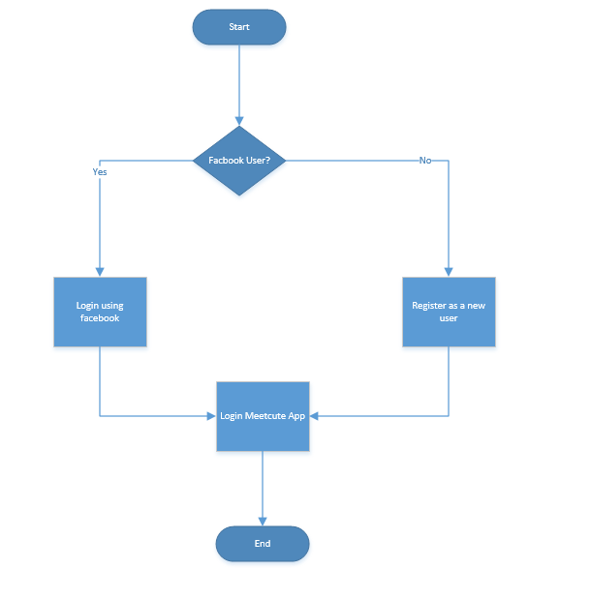
Flow for the login page:

Slide 23
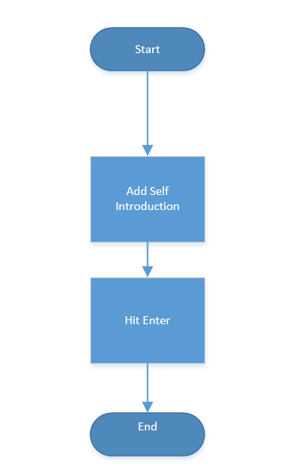
Flow for the Profile Page:

Slide 24
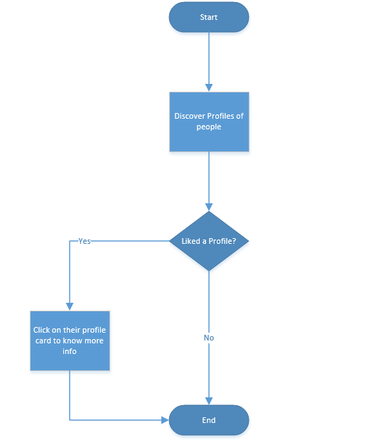
Flow for the Discover Page:

Slide 25
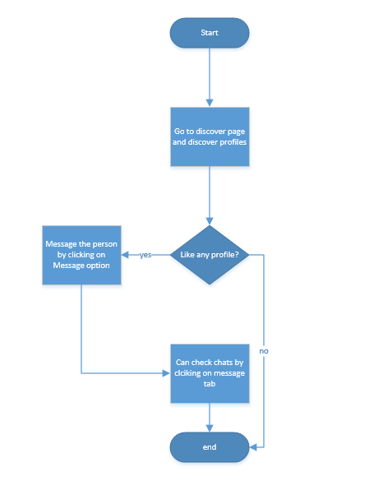
Flow for Messaging:

Slide 26
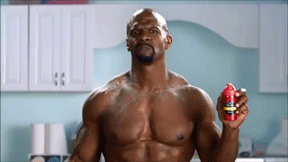
MeetCute;)
Testing
Daniel
Notes:
(need spreadsheet of bugs, valid/invalid cases, equivalence classes) even if we didn't write tests, demonstrate we know what is needed

Slide 27
Testing
Unit testing
Integration test
Accept testing
Code coverage
Metric
Notes:
chai

Slide 28
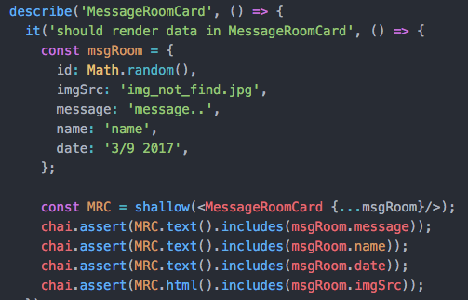
Unit Test
MessageRoomCard
Input data into a react component See it renders or not. chai, mocha
Notes:
Plz don’t change it

Slide 29



Acceptance testing
Acceptance testing is the process of taking an unmodified version of our application and testing it from the “outside” to make sure it behaves in a way we expect. Typically if an app passes acceptance tests, we have done our job properly from a product perspective.
Selenium and WebdriverIO
->Chimp

Slide 30
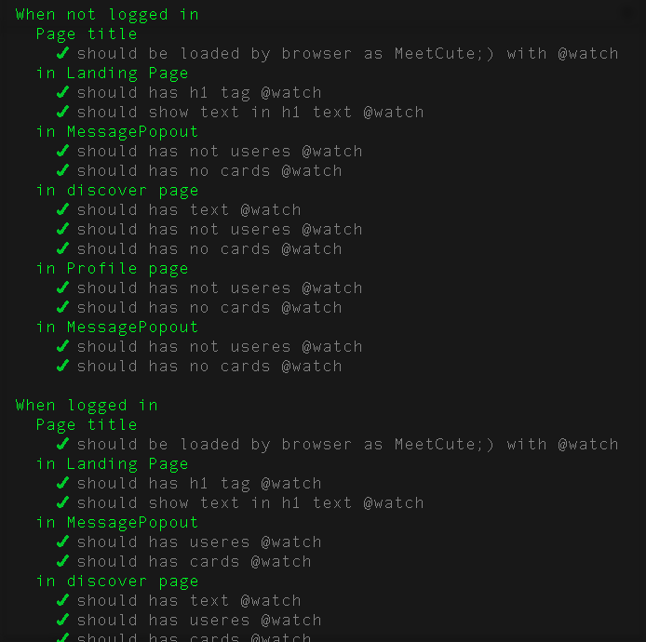
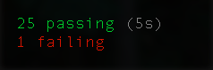
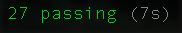
Acceptance Test
Example

Slide 31
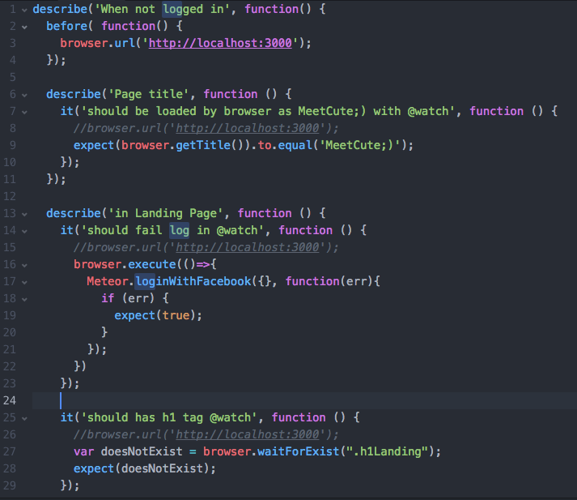
Acceptance Test
Example
Given a page,
when not logged in, then log in should fail. then title should be there.
then log in button should be there.
then head text should be there.

Slide 32
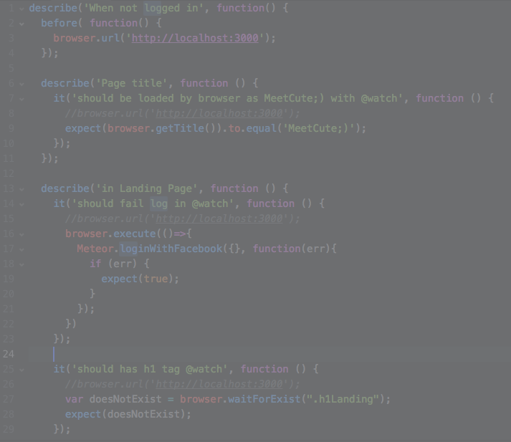
Acceptance Test
Example
Given a page,
when not logged in, then log in should fail. then title should be there.
then log in button should be there.
then head text should be there.
Notes:
(need spreadsheet of bugs, valid/invalid cases, equivalence classes) even if we didn't write tests, demonstrate we know what is needed

Slide 33

MeetCute;)
Refactoring
Daniel

Slide 34
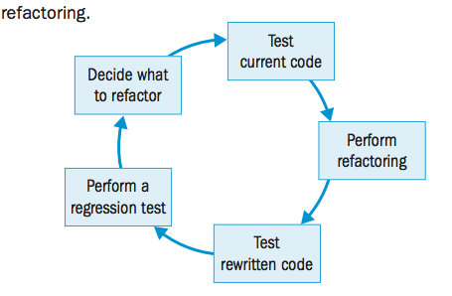
Refactoring Goal
Avoid Repetition (DRY).
Readability.
Help find bugs and maintain.
Improve design pattern.
Testing -> Refactoring -> Testing

Slide 35
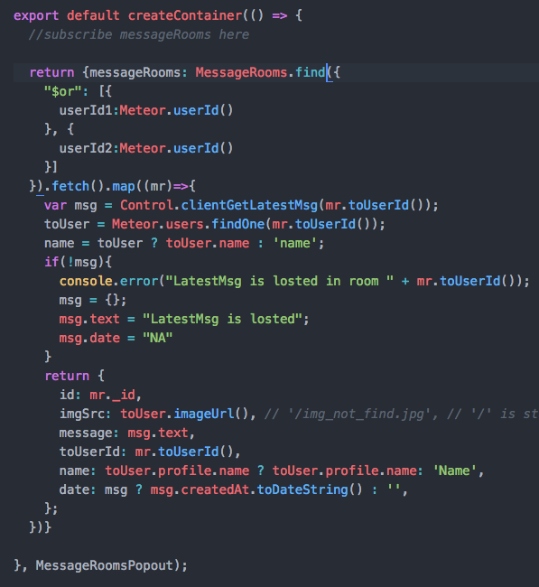
Refactoring Example - Before
All tasks are in the same function
Query MessageRooms
Extending attr to each Room
Return to React component

Slide 36
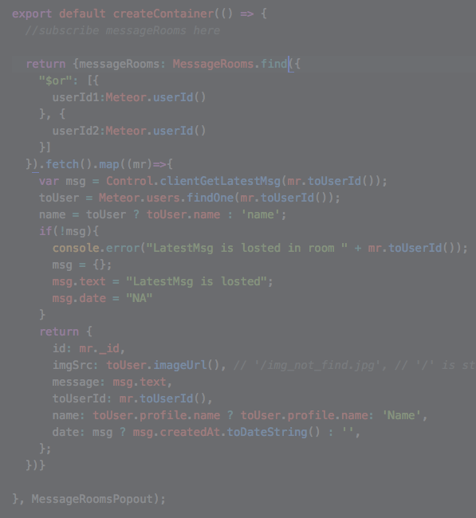
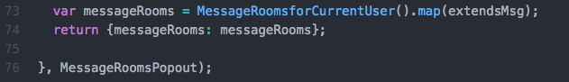
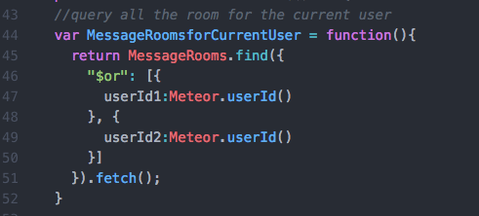
Refactoring Example - After
Extract Method
Query Method
Extending attr Method
Testing Passed

Slide 37
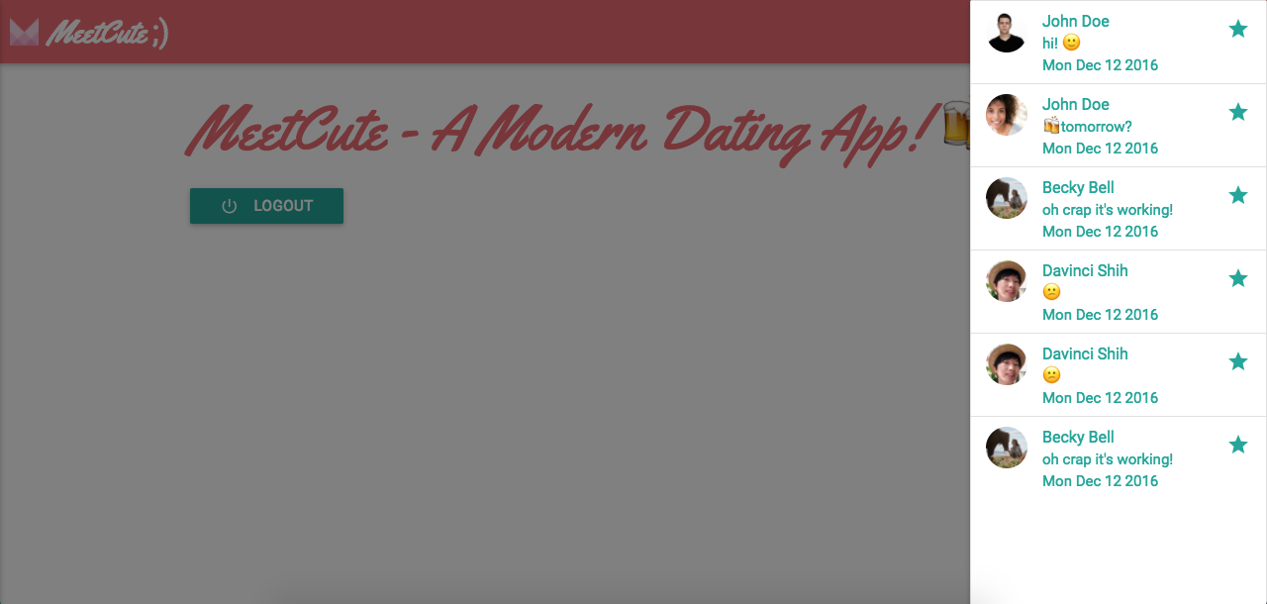
Defect Management

Slide 38
Defect Management
Defect Discovered and acknowledged by team members
Defect resolution carried out after consultation with mentor

Slide 39
MeetCute;)
Metrics
Ian & Daniel

Slide 40
Testing Metrics
Time log | Test Description | Test Priority | Status
13:21 12/12 2016 | When not logged in | 1 | passed
13:21 12/12 2017 | Page title | 1 | passed
13:21 12/12 2018 | ✓ should be loaded by browser as MeetCute;) with @watch | 1 | passed
13:21 12/12 2019 | in Landing Page | 1 | passed
13:21 12/12 2020 | ✓ should has h1 tag @watch | 1 | passed
13:21 12/12 2021 | ✓ should show text in h1 text @watch | 1 | passed
13:21 12/12 2022 | ✓ should show Facebook log-in button @watch | 1 | passed
13:21 12/12 2023 | ✓ should show sign in text @watch | 1 | passed
13:21 12/12 2024 | ✓ should fail log in @watch | 1 | passed
13:21 12/12 2025 | in MessagePopout | 1 | passed
13:21 12/12 2026 | ✓ should has not useres @watch | 1 | passed
13:21 12/12 2027 | ✓ should has no cards @watch | 1 | passed
13:21 12/12 2028 | in discover page | 1 | passed
13:21 12/12 2029 | ✓ should has text @watch | 1 | passed
13:21 12/12 2030 | ✓ should has not useres @watch | 1 | passed
13:21 12/12 2031 | ✓ should has no cards @watch | 1 | passed

Slide 41
Valid/Invalid Cases
Model | Actions | Member Owner | Member Non-Owner | Non Member
User.Profile | Update | ✓ | x | x
User.Profile | Insert | x | x | x
User.Profile | Remove | x | x | x
Message | Update | x | x | x
Message | Insert | ✓ | ✓ | x
Message | Remove | x | x | x
MessageRoom | Update | ✓ | x | x
MessageRoom | Insert | x | ✓ | x
MessageRoom | Remove | x | x | x

Slide 42
Stats from Github
In the past month:
“Excluding merges, 6 authors have pushed 64 commits to master and 69 commits to all branches. On master, 99 files have changed and there have been 26220 additions and 186 deletions.”

Slide 43
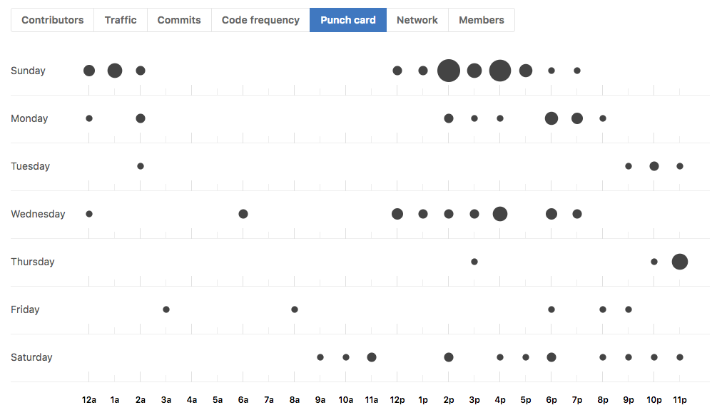
Punch Card

Slide 44
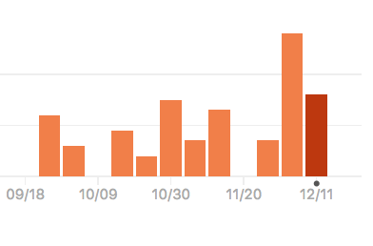
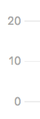
Number of commits with time
175 commits total

Slide 45
Product Metrics
Product Metric | In More Detail
Sign Up / Log In | Registering and Accessing WebApp as a new/old user
Single Thread Messaging | 1 to 1 messaging
User List | Every registered user
Notification Log | Inbox of current/old messaging threads
User Profile | Users picture, name, and bio
Portability | Web Application (I.E. Chrome)
Complexity | A simple peer to peer messaging application
Size | 178mb

Slide 46
Process Metrics
Process Metric | Category | Person Hours
Discover+ Profile Page | Coding | 12
Messaging | Implementation | 25
Web App Flow Chart | Diagrams | 3
Testing | Acceptance Testing | 10
Refactoring | Coding | 6
Documentation | SPPP / SDD | 4
Hosting | Deployment & Config | 5

Slide 47
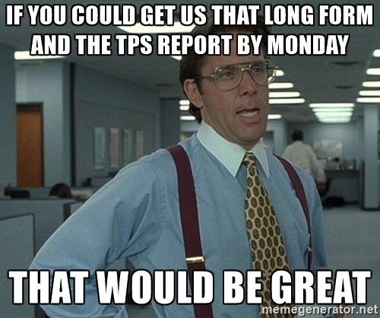
MeetCute;)
Project Management
Becky

Slide 48
Process Model and Results
Agile style process:
3 week iterations
Weekly standups
Daily when closer to final deadline
Retrospective/lessons learned at the end of each sprint
Did not implement due to time constraints
Weekly planning phase - (Sunday meetings)
Used Pivotal Tracker to manage and assign tasks, bug reports
Didn’t use as much for bug reporting as intended

Slide 49
Project Objectives
Learn new JavaScript framework
Build responsive, mobile-friendly CRUD webapp
Something interesting enough to continue work on
Focus on core features, not a lot of frills
Goal of creating a quality/stable app.
Can a group project be executed relatively painlessly and with mutual respect?

Slide 50
Risks
Knowledge risks: JavaScript - Low due to paired programming Git/Github - Low due to tutorial availability & guides (In hindsight: Medium) Meteor framework - Low due to vast availability of examples / literature (In hindsight: Medium) Complex features in a too short time frame - Medium - Will need to manage scope to prevent feature creep (In hindsight: High)
Schedule/Time Management risks: Some group members are either remote, in multiple classes & conflicts due to midterms/work,etc.. - Low - Mitigated by use of online tools for meetings / communication, and collaboration via internet. (In hindsight: High)

Slide 51
Schedule
Met weekly at Mugar Library Sundays at 2:00pm
When unable to meet in person, teammates used Google Hangout and Slack to participate
Sample Agenda:
Standup
Review of past week’s code changes
Design discussion
Pair Programming (moreso together-programming)

Slide 52
Monitoring
Daily communication on Slack
Mentor relationships + Github code reviews
Intent for everyone to come to same programming level by doing Meteor tutorials
Fell short of this due to lack of time
Weekly code reviews and pair programming helped fill the gaps
Mid-week standup

Slide 53
Process Improvement
Obstacles we encountered | Changes to Process
Disparate understanding of app | Mentor/code reviewer relationships Spent more time programming together Weekly code change reviews Created tutorial docs
Losing touch of each other’s progress | More frequent standups/checkins Working together more often than alone Sharing more links

Slide 54
MeetCute;)
Security Concerns
Gabriel A. Leake

Slide 55
Initial Risk - NoSQL Injection
Users could potentially send fake messages!
Message NoSQL Injection
Need: Message/User ID’s
Action: Fake messages
Why?
All the data is mirrored client/server
Users have admin access to DB

Slide 56
Preventing NoSQL Injection
-Removed Insecure package
Prevent admin privileges on database
-Create meteor methods & utilized check package
Allows for validation of fields - prevent Mongo operators as args
Separate client code from database logic
Meteor.call - parallel client/server run
-Limit exposed data to the client database - removed autopublish
We exposed userId’s and messageRoom ID’s which should be kept private
Notes:
The client sends a request to the server to run the method in a secure environment, just like an AJAX request would work
A simulation of the method runs directly on the client to attempt to predict the outcome of the server call using the available information

Slide 57
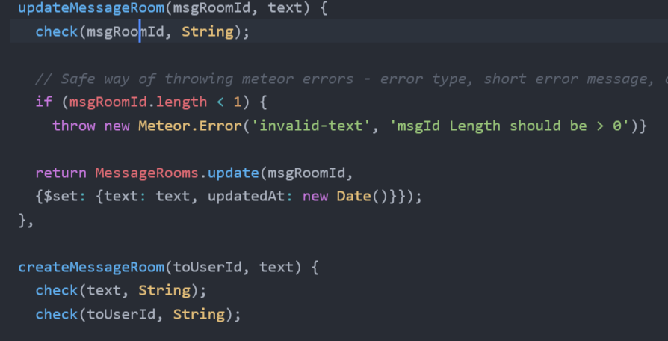
Meteor Methods
Prevent CRUD operations from console/to miniMongoDB

Slide 58
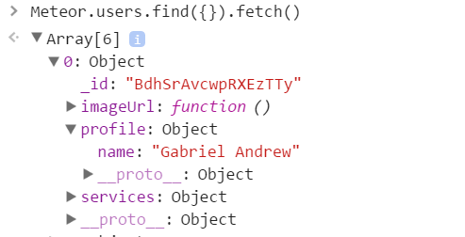
Data Exposed
UserIDs
Risk mitigated - We only publish messages/message rooms that involve the logged in user.

Slide 59
Data Exposed (Cont…)
Showing full name from Facebook
Users could export names from browser
Sell the data
Harass users/stalking
Mitigate: Generate username/show first name only.

Slide 60
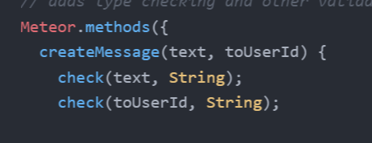
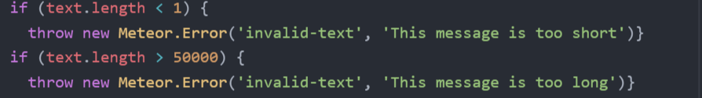
Checking input
Notes:
Method only takes the toUserId and the text, and always sends it from the logged in user

Slide 61
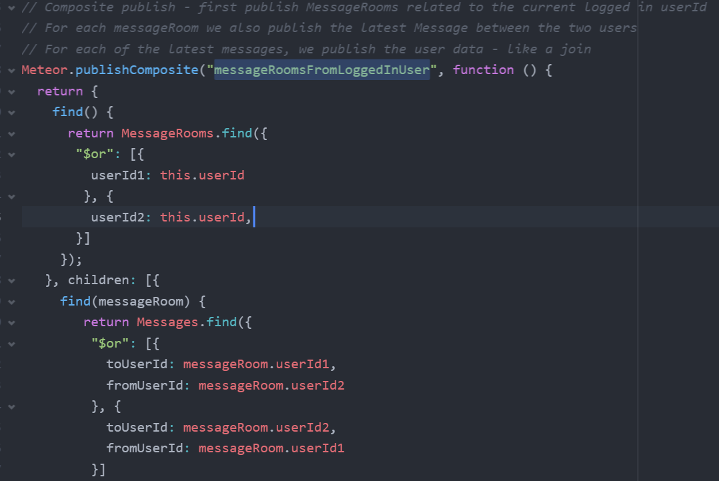
Prevent data exposure
-Removed autopublish package
Added publish/subscribe message pattern
Server:

Slide 62
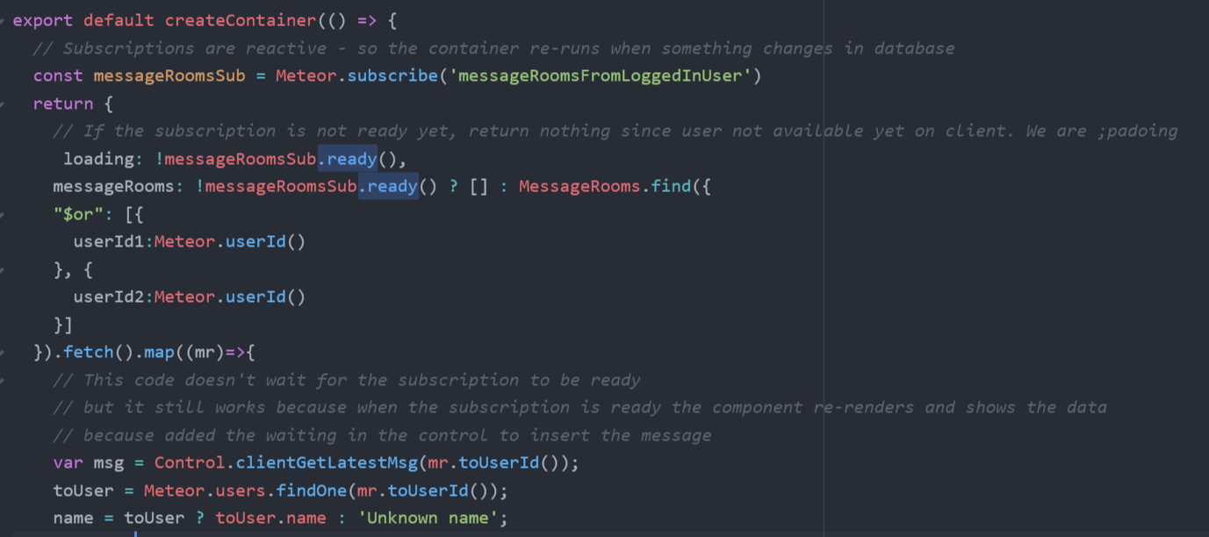
Prevent data exposure (cont…)

Slide 63
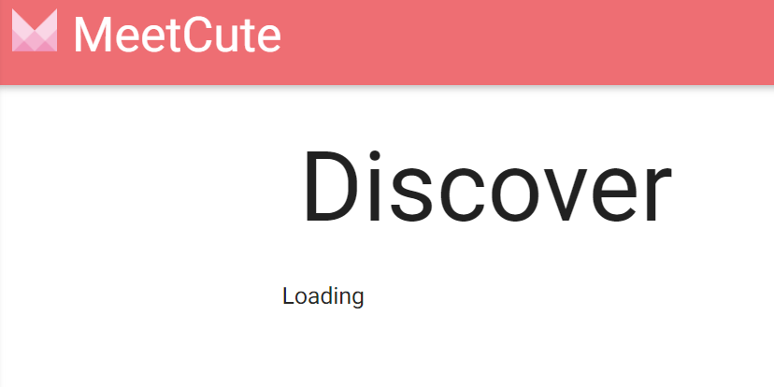
Manual Security tests
What if I navigate to the screens while logged out?

Slide 64
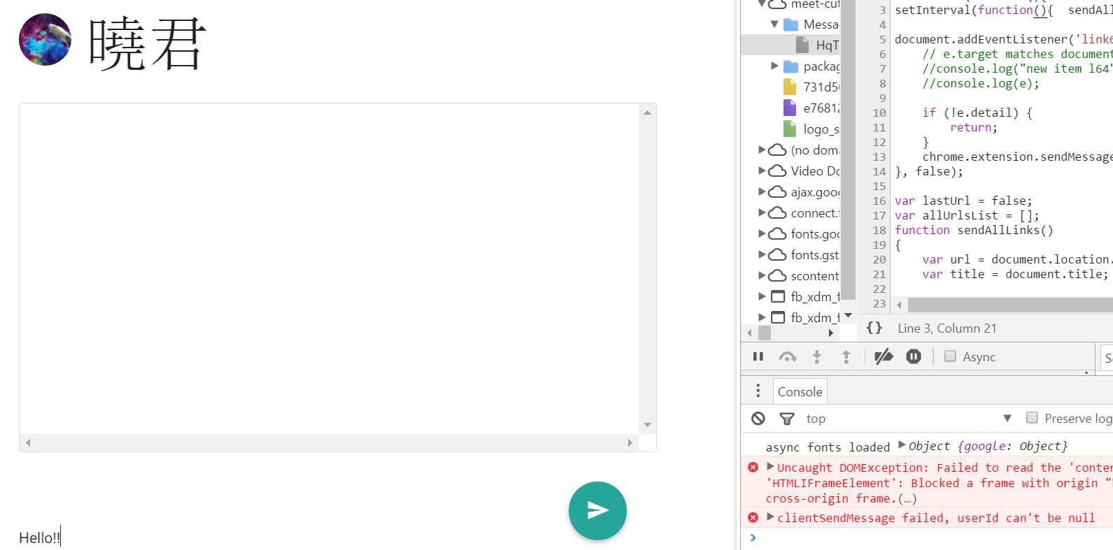
Security Tests (cont…)
Try to message a user whilelogged out

Slide 65
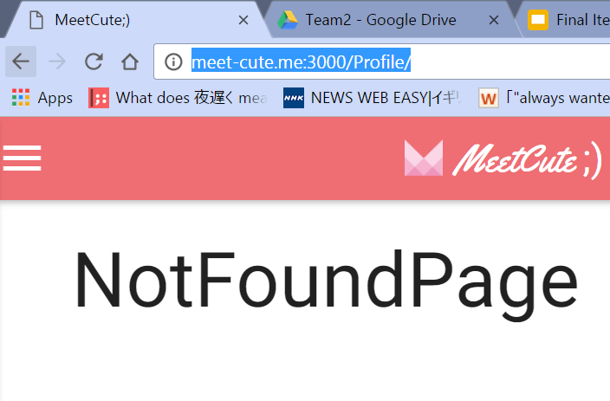
Security tests (cont…)

Slide 66
Facebook Login Security Risks
Uses OAuth as previously mentioned.
Application gives up control of its userbase
Controlled by OAuth provider (Facebook)
Application could get shut off at any time by provider
A hacked Facebook grants access to MeetCute + all other applications
Mitigate w/ two factor auth/password on login
Shares data w/ Facebook - likes/comments
Notes:
There are ways to limit this type of exposure, such as multi-factor authentication or simply rerequesting the password on each login.

Slide 67
Future Security Enhancements
Add browser-policy package:
Prevent code piggy backing
X-Frame-Options: Limit sites that can frame the app
Protects against: Clickjacking
Content-Security-Policy: Attack detection
Reports/Mitigates: XSS
Notes:
Meteor.startup.BrowserPolicy

Slide 68
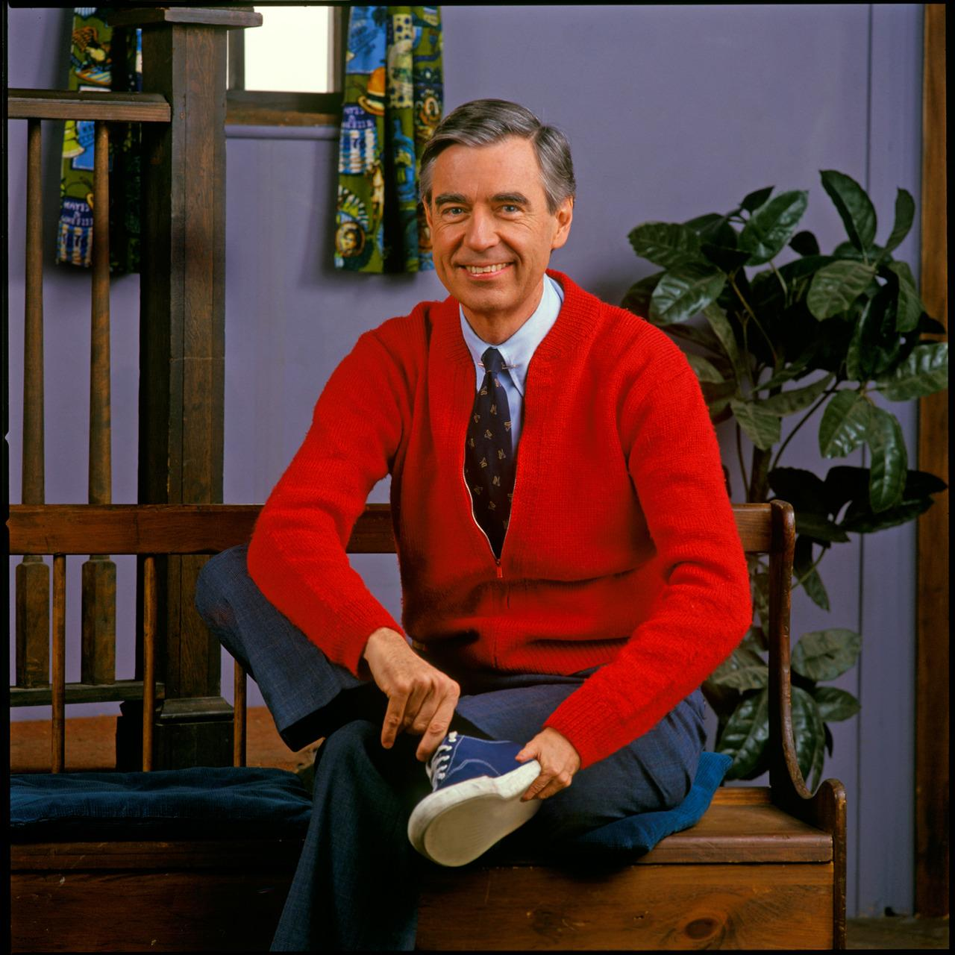
MeetCute;)
Lessons Learned

Slide 69
Overview
Positive experiences | Challenges
Popular frameworks = lots of knowledge | New technology stacks create additional challenges
Online tools add efficiency | Co-location is superior (when possible)
Cooperative/eager teams are great | Tutorials aren’t enough
Helping one another builds skill | Don’t save it all for the weekend

Slide 70
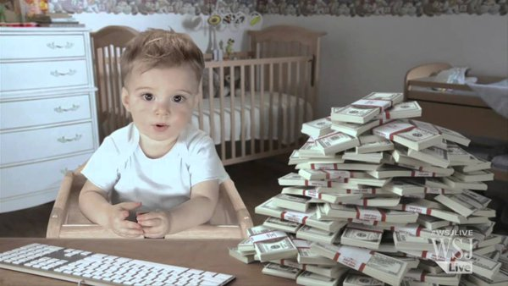
MeetCute;)
Future Work
Gautam *
* The above image is not of Gautam.

Slide 71
Completion + Future Work
Finish Testing
Security measures for app that we deployed - DO - DDoS and SSL certificates
Mobile version - Dating apps more popular on mobile - By React-native or phonegap
We can order discover results by relevance - implement algorithms (Neural Network - BrainJS)
Favoriting Users
Geolocation Features
Blocking functions

Slide 72
References
Security:
https://en.wikipedia.org/wiki/OAuth
http://stackoverflow.com/questions/4727226/on-a-high-level-how-does-oauth-2-work

